Slide 1
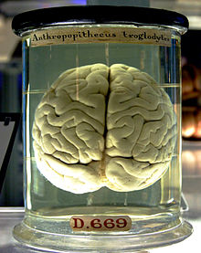

human memory
http://en.wikipedia.org/wiki/File:Chimp_Brain_in_a_jar.jpg

Slide 2
types of memory
timescale
seconds
sensory memory
short-term memory (STM)
minutes
mezzanine memory
hours/days
long-term memory (LTM)
lifetime
Notes:
Sensory Memory: The memory that is immediately associated with our senses
Short term memory contains the information, on which our brain is working right now.
Long term memory: like remembering some book from childhood, childhood memories, etc.....
Mezzanine Memory: memory of last few hours, or a day etc

Slide 3
sensory memory

Slide 4
at the sensors
after images
habituation
... always sense change
Notes:
Stae at red cross with 1 eye for in full screen for at least 20 secs n then look at whie background u’ll c the pink n purple image by sensory memory

Slide 5
at the sensors
Notes:
Stae at red cross with 1 eye for in full screen for at least 20 secs n then look at whie background u’ll c the pink n purple image by sensory memory

Slide 6

Notes:
Stae at red cross with 1 eye for in full screen for at least 20 secs n then look at whie background u’ll c the pink n purple image by sensory memory

Slide 7
in the brain
buffers for stimuli received through senses
iconic memory: visual stimuli
echoic memory: aural stimuli ... what did you say?
haptic memory: tactile stimuli
continuously overwritten

Slide 8
short-term memory

Slide 9
short-term memory (STM)
also called ‘working memory’
scratch-pad for temporary recall
rapid access ~ 70ms
rapid decay ~ 200ms
limited time ~ 30s without rehearsal
limited capacity – 7± 2 chunk
Notes:
At times, we even close our eyes to concentrate on our working memory and not get distracted by any vision or anything.

Slide 10
Millers 7+/-2
2832
1387430
212348278493202

Slide 11
seven ‘chunks’ meaning matters
42194520011066
42 1945 2001 1066
0121 414 2626
HEC ATR ANU PTH ETR EET
HEC ATR ANU PTH ETR EET

Slide 12
long-term memory

Slide 13
long-term memory
repository for all our knowledge ... and who we are
slow access – relative to STM
slowly created – rehearsal
slow decay, if any
huge or unlimited capacity

Slide 14
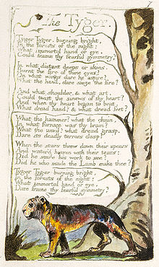
types of (explicit) LTM
episodic
serial memory of events
may be hard to recall out of order
semantic / declarative
structured memory of facts, concepts, skills
links and associations
http://en.wikipedia.org/wiki/File:The_Tyger_BM_a_1794.jpg
Notes:
Episodic memory: e.g. Story of a drama, reading a book, if i ask u to sing the 3rd verse of a poem (hard to remember)
Semantic Memory: e.g. When we celebrate independence day of Pakistan, what is your date of birth, what is the formula to calculate distance, etc.
When ppl loose memory in case of accident or something, they usually tend to loose their episodic memory, not the semantic memroy.

Slide 15
associative
concepts linked to one another
finding a start point?
external cues
recognition vs. recall
e.g. menus vs command line
Notes:
Recognition is easier as compared to recall.

Slide 16
explicit memory
episodic & semantic memory
explicit / conscious
you know that you know
not all memory like that ....

Slide 17
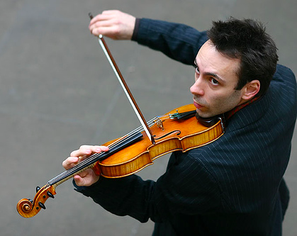
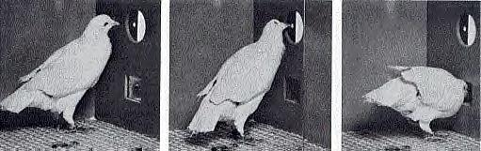
implicit / tacit knowledge
motor memories
playing an instrument
typing using keyboards
automatic reactions
Pavlov and Skinner
expert knowledge
http://www.flickr.com/photos/protographer23/358987856/
Notes:
Motor memories: typing using keyboard, the fingers know which key to press to type a certain character
Automatic Reactions: we learn how to react in certain situation from our past experience. Pavlov’s experiment on dogs, skinner’s experiments on pigeons, rats etc Person on road when hear the sound of very very fast running car, get very very concious not to cross the road
Expert Knowledge: if u ask a programmer how he does the programming, they probably find it very hard to tell how they do it.

Slide 18
linked
from explicit to implicit
proceduralisation: the process of transforming a controlled conscious activity into an automatic unconscious activity through repeated practice
from implicit to explicit
Introspection or externalisation: the examination or observation of one's own mental and emotional processes
implicit associations activate explicit recall
Notes:
Explicit to implicit: as we do maths, we do programming. Initially explicitly we doo it and with lots of practicing we can do it implicitly
Implicit to explicit: carefully notice myself, e.g. While typing i mistype , then i’ll look on the keyboard what mistake i’ve been doing and rectify, some athletes do that they watch their videos of last games to rectify their deficiencies etc. Or to monitor our bad habits, etc
Implicit associations activate explicit recall: e.g. Something’s cooking at home and we get the smell, we’d think about the food whose smell is like that, or we would like to guess the food being cooked. So the implicit association with the food and smell activates our thoughts to recall the food or last when we’ve had that or with whom we had that, etc.

Slide 19
mezzanine memory

Slide 20
mezzanine memory
what you are doing now
context – activates LTM
what you have been doing recently
short-term episodic memory
Notes:
What you are doing now context activates LTM example: i am giving lecture how come i know because i am facing 40-50 students, multi-media, my environment is telling me that i am giving a lecture, even if i close my eyes i won’t forget that i am giving a lecture. Its not in Short term memory that im giving lecture i.e. My brain is not constantly reminding me “ im giving a lecture” “im giving a lecture” “im giving a lecture”
What u’ve been doing is like short term episodic memory e.g.if i ask u what’v u done since u wake up in the morning.

Slide 21

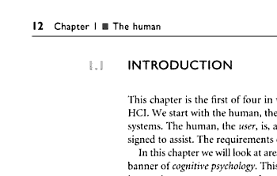
where studied
cockpits and control rooms
situation awareness
Reading
long-term working memory
http://en.wikipedia.org/wiki/File:Swiss_Saab_2000_Cockpit.jpg

Slide 22
comparison
short term long term mezzanine
capacity 7+/-2 chunks big! ?
decay ~30s lifetime ? mins–hours needs rehearsal
laying down implicit repetition implicit

Slide 23
reliable memories?
Notes:
How reliable the memories are?

Slide 24
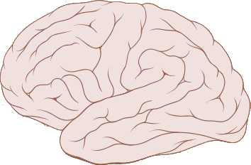
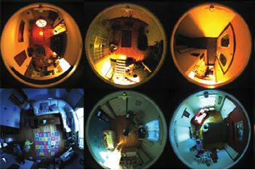
semantic not photographic
perception
encode
reconstruct
memories
all memories are constructed
➔ confabulation
false memories
e.g. Deb Roy @ MIT, first steps
Notes:
Annie story:
Annie walked through the door and sat down. Its been a long long day in the office and she was tired, so relaxing she picked up her cup of coffee and watched her cat called charlie. Charlie walked past her and sat on a white rug for a moment and then came towards her and moved against her legs. The fire burnt brightly before them and she almost fell asleep.
Tell me the colour of the cat....

Slide 25
Activity
Choose an application or device (desktop, web or mobile) that you use frequently.
Step through one or two main functions.
Write out the steps you take and then note what you need to remember in order to perform each step. What kind of memory is needed for each step: short-term, mezzanine, or long-term?
Look for places where there is high short-term memory load. Have you had problems when interrupted during these steps?

